Slide 1
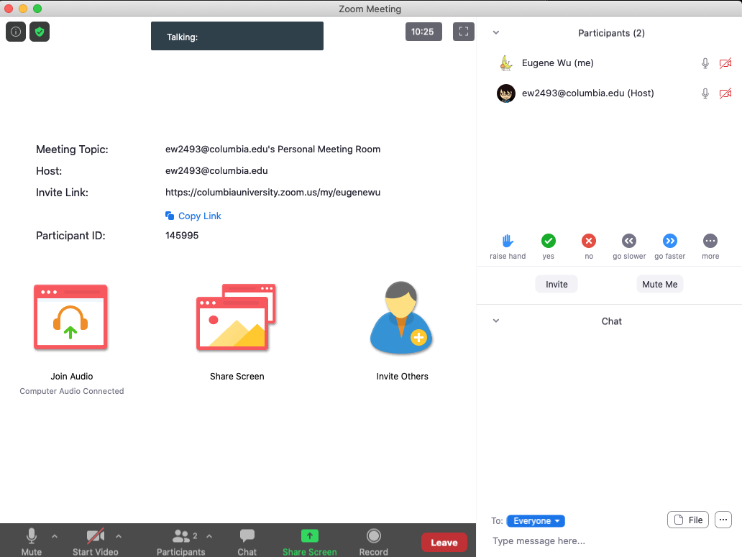
Setup Zoom to Look Like This
Participants
Chat

Slide 2
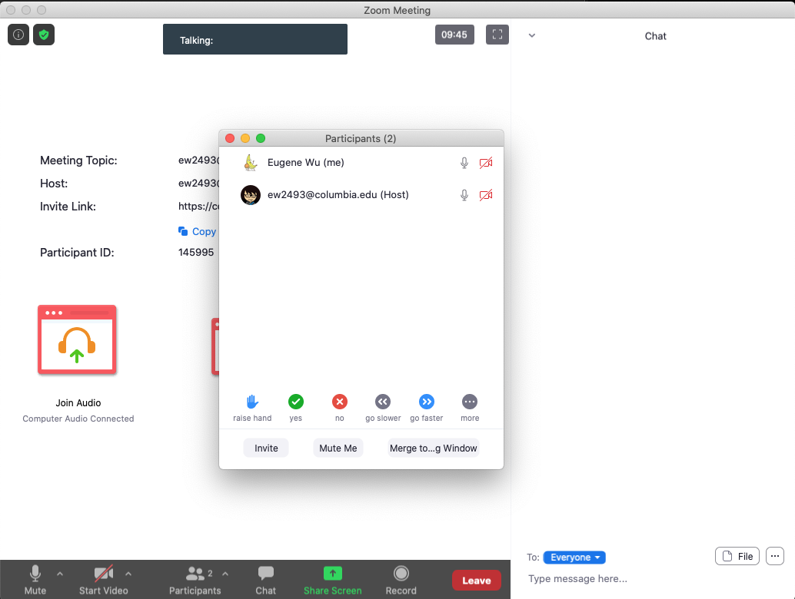

Using Zoom
Open Chat & Participants
Merge Window
Click the green check in the participants list when done
2
1

Slide 3
Participation Protocol
Raise Hand to speak
Share thoughts and questions in chat
Thank/applaud colleagues that speak up/present

Slide 4
Is it possible for 1 + 1 = 3??? If so, when?
Open chat and share what you think
Chat

Slide 5
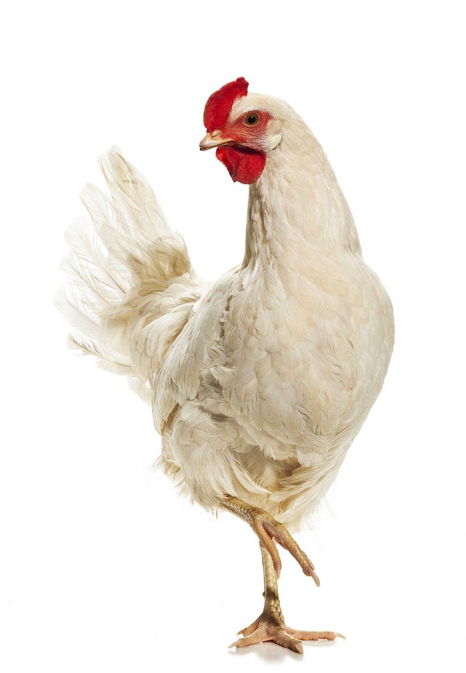
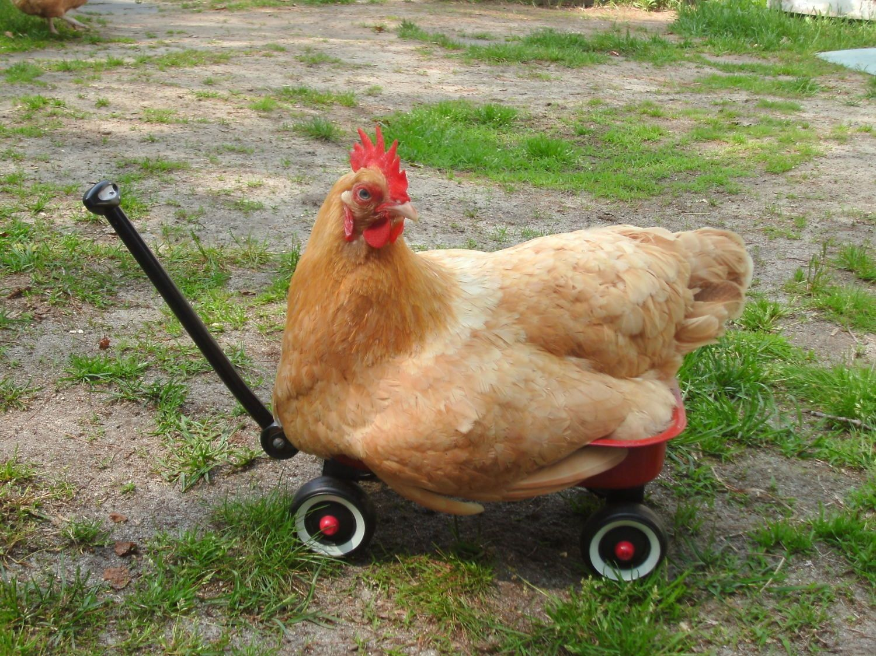
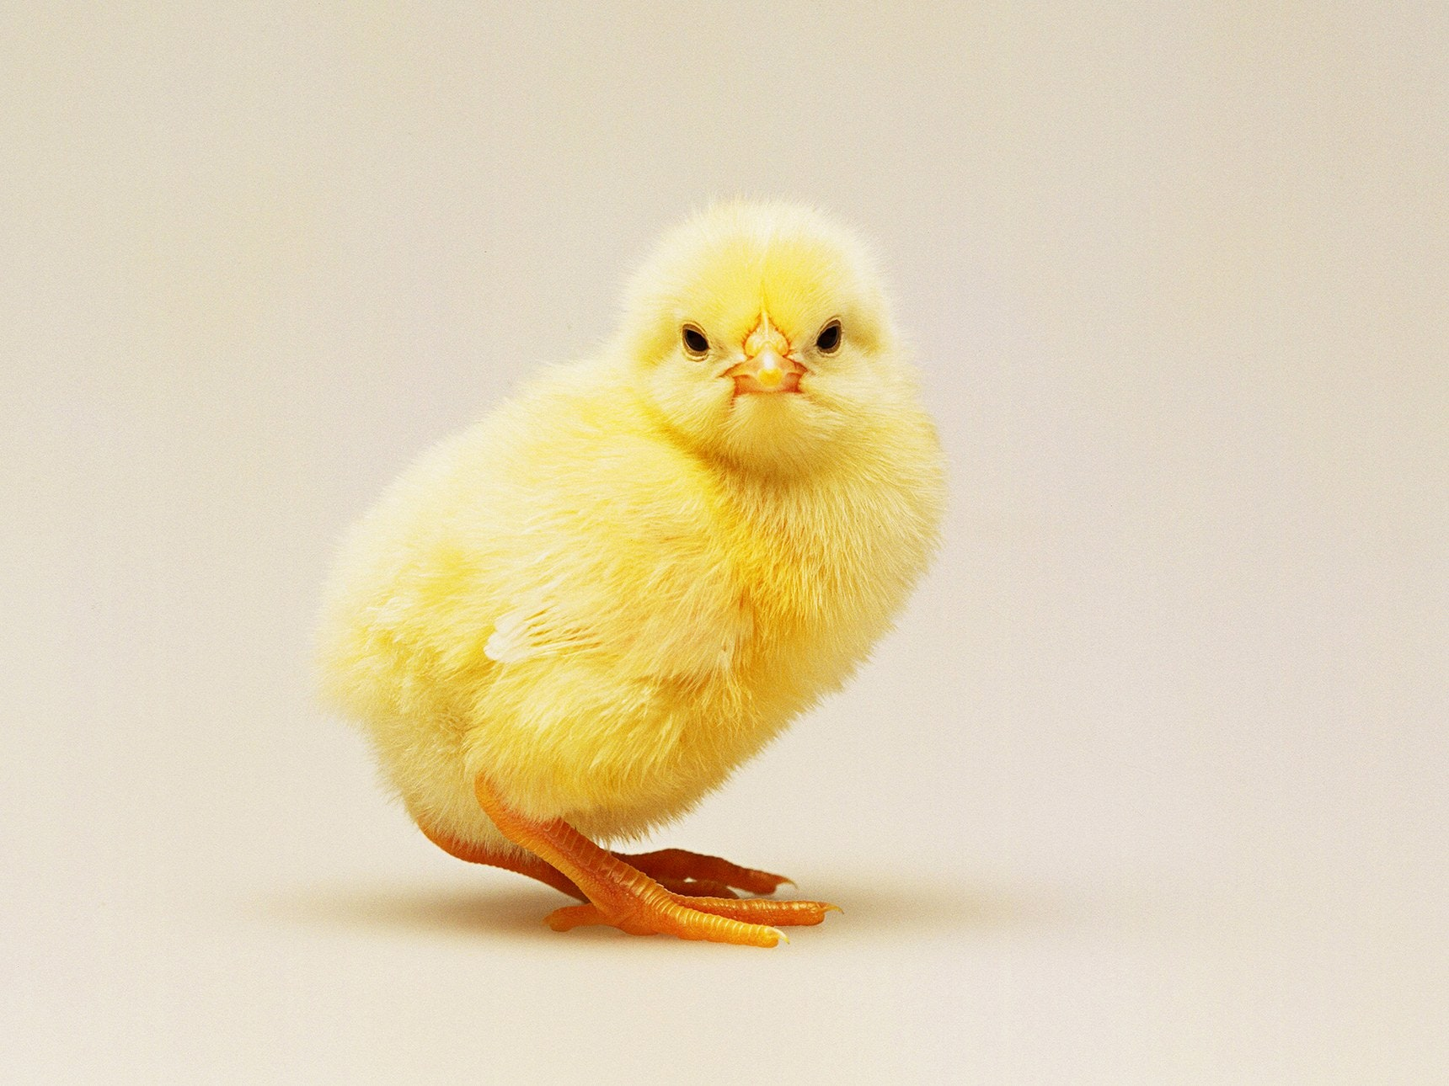
+

Slide 6
Participation Protocol
Raise Hand to speak
Share thoughts and questions in chat
Thank/applaud colleagues that speak up/present
I may ask individuals to share thoughts on the readings

Slide 7
Using Zoom
Give a green check when done

Slide 8
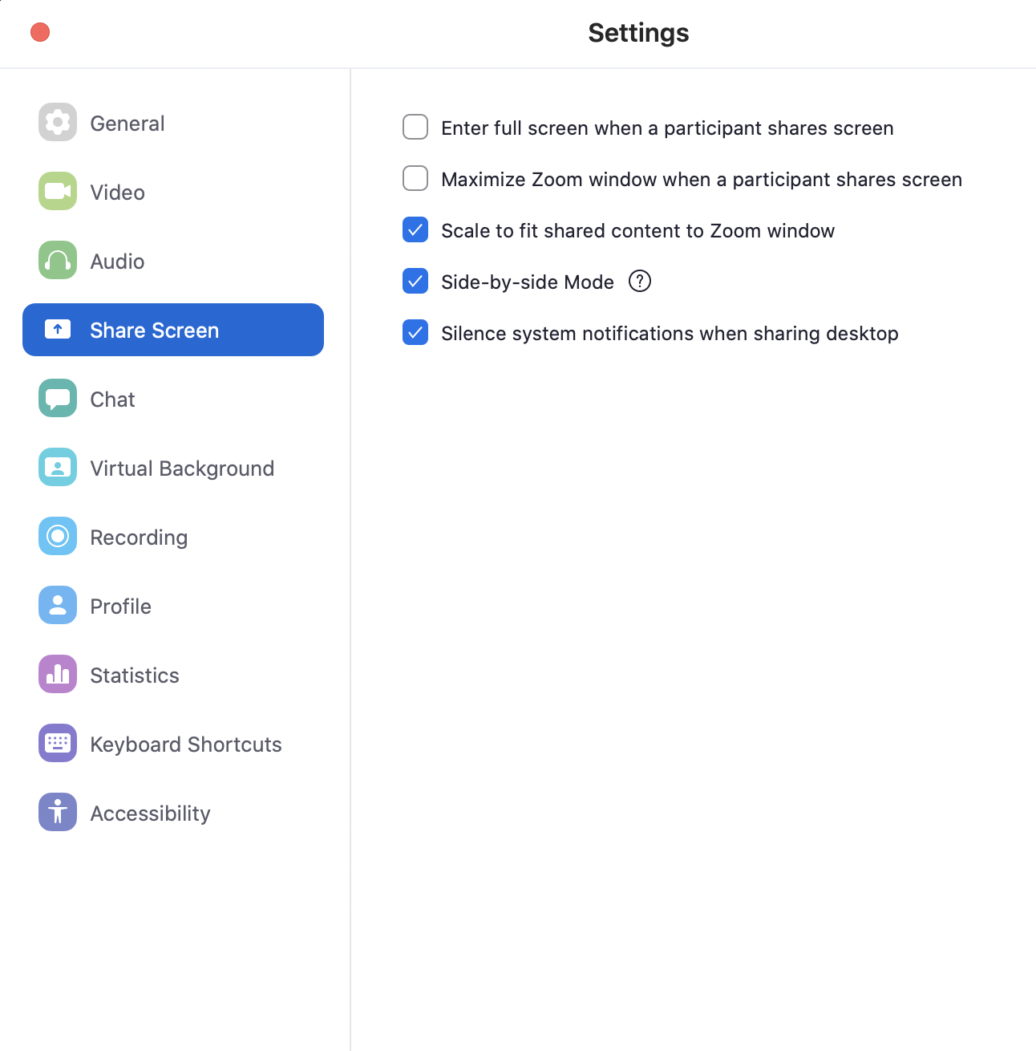
Using Zoom
Give a green check when done
Uncheck this

Slide 9
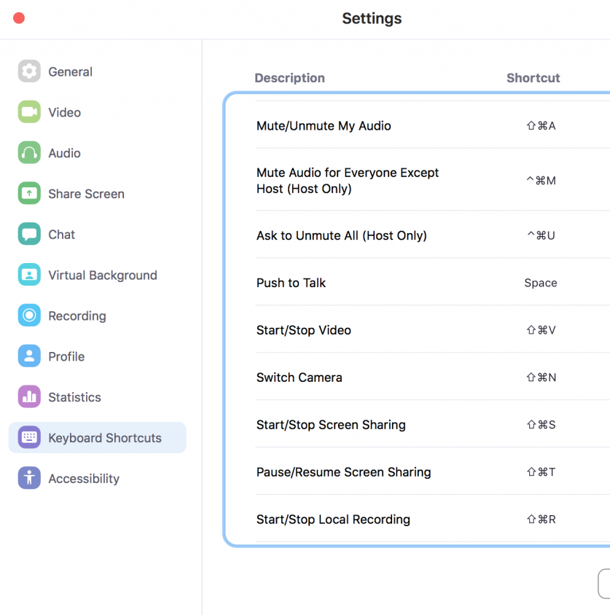
Using Zoom
Raise hand ⌥y
Enable Mic space
Toggle video ⌘⇧V
Toggle chat ⌘⇧H

Slide 10
Using Zoom
Raise hand ⌥y
Enable Mic space
Toggle video ⌘⇧V
Toggle chat ⌘⇧H
Turn your video on,
enable the Mic,
and say
“Hi, my name is _____”

Slide 11
COMS W6113 Topics in Database Research
Eugene Wu
http://w6113.github.io

Slide 12
Database Research
Declarative API to manage data
Defines and enforces clear semantics
Model the data, query, transactions, hardware, etc
Combines PL, systems, theory, optimization, ML to
Maintain data integrity (under failures)
Run queries correctly and quickly
Support application needs

Slide 13
Database Research
Definition of data changing
Records
Graphs
Sensor events
Images & Videos
Documents & PDFs
VR/AR…
Application needs are growing
Hardware, scalability, ML, real-time
Decision making, data exploration, video analytics, etc

Slide 14
This Course
Learn about Database Research
Read classic and modern papers
Work on a research project
Learn how to read papers
Problem selection
Insights and technical contributions
Presentation

Slide 15
Course Topics
Query Execution
Query Optimization
Columnar Stores
Query Compilation
Large-scale Dataflow
Materialized Views
Datalog and Lineage
Physical database optimization
<Your interest here>

Slide 16
Course Topics
We will NOT cover material in 4111, namely
Relational Algebra
SQL
Basics of query execution and optimization
Access methods
Basic design of disk-based database systems

Slide 17
What you will do
Project (65%)
Groups of 2-3
Assignments (15%)
See how pieces of a DB engine fit together
Paper Reviews (10%)
Answer questions for each paper & submit review on wiki
Lots of reading!
Class discussion (10%)

Slide 18
Project
2 Broad Categories
Reproduce and extend
Research project

Slide 19
Reproduce (& Extend)
Reproduce
Read and deeply understand a data management topic
~5 to10+ papers, summarize & compare them
Implement best/combined technique in DataBass/another sys
Benchmark it
& Extend (bonus)
Extend the implementation to make it a bit better
Benchmark to show it is better
Explain when and why the extension is effective

Slide 20
Research Project
Investigate new ideas and solutions
Define hypothesis
Conduct research
Evaluate hypothesis
Writeup and research
Emphasis on hypothesis and evaluation
Translate contributions into testable hypotheses
Evaluation should evaluate hypotheses

Slide 21
Project Overview
Choose from list of projects, or come up with your own
Pick partners, 1 page proposal
Problem you are solving
Hypothesis
Plan of attack, with milestones
Preliminary related work
Demo/Presentation session
Project report

Slide 22
Project Timeline
We are here to help you succeed
Week
02 Release list of projects
04 Submit proposal
Discuss with staff before this stage
07 Submit paper draft
Position relative to state of the art
Play with related tools
11 Check in
14 Showcase
15 Submit paper 8-10 pgs

Slide 23
Programming Assignments
DataBass: Python DB engine ~4K loc
Hands-on experience with query from parsing to execution
A0: add ORDERBY clause
A1: hashjoin, pushdown optimization
A2: selinger join optimization
A3: hashjoin compilation
A4: benchmarking
A5: lineage
A0
A2
A1
SQL
parser
optimizer
interpreter
Compiler + lineage
A3-5

Slide 24
Class Format
Submit paper review before class
Quiz for self assessment
Breakout to discuss quiz/reading
Go over paper ideas
Use chat to ask/answer questions
Optional: sign up to lead discussions
Optional: scribe the discussion, add to course wiki

Slide 25
Reviews
Add to course wiki
Can skip 4 paper reviews (note: 1+ papers per class)
Late submissions not accepted
Questions
What is the problem?
Why does prior work fail to solve it?
Main insight and technical contributions?
Do the evaluations hold up?
What do you wish could be improved?

Slide 26
Reviews
Do not plagiarize
Write original reviews
Do not copy text from papers, online, or other reviews
See http://www.cs.columbia.edu/education/honesty

Slide 27
Presentation
15-20 minutes + discussion
Cover key elements of paper
Find & read related work to provide context
Intuition >> formulae
Create your own examples. Plagiarism rules apply
Lead discussion with questions
Go over presentation with Eugene ahead of time
Send slides to TA 2 days before class, by midnight.

Slide 28
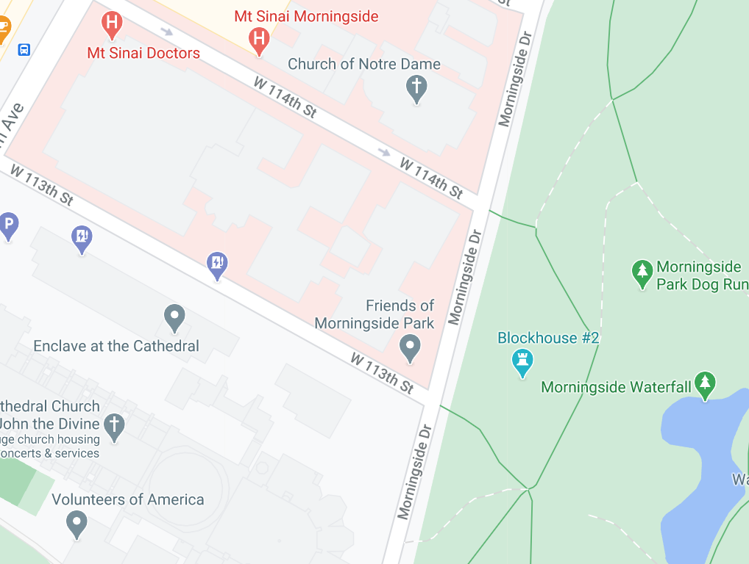
Recitation
Tues 2-3PM EST, an open air space (113th & Morningside)
Attendance is not taken
Purpose
Go over examples
Research advice
Life advice
Stay safe from COVID

Slide 29
Who am I?
Eugene Wu
421 Mudd (DSI space)
ewu@cs.columbia.edu
OH: Tues 3-4PM EST
PhD MIT, 2015
Started @Columbia Fall 2015
Systems for Human Data Interaction

Slide 30
Deka Auliya Akbar
TA for the class
OH: tba

Slide 31
Logistics
w6113.github.io
Class T/Th 11:30 – 1PM, Zoom
Recitation Tues 2-3PM, open air location TBD
Commun. Slack
Reviews Course wiki
Academic Honesty
See http://www.cs.columbia.edu/education/honesty
Ask if unsure, falling behind, etc
Don’t plagiarize. Worse than failing.

Slide 32
Prereqs
Required: 4111 Intro to DB
Declarative languages and data independence
Relational algebra, SQL, relational model
Query optimization and execution
Useful: 4112
Great to have people with different backgrounds
Talk to me if unsure
If graduate student from different area, talk to me

Slide 33
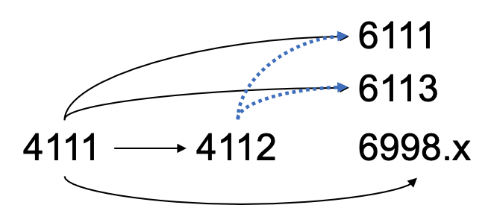
Relationship with other DB classes

Slide 34
Enrollment
~25 students
Doesn’t matter if enrolled or waitlisted
Admission based on quality of
First reviews
Participation in initial classes

Slide 35
Grading
Project 65%
Assignments 15%
Reviews 10%
Participation 10%
No curve, everyone can get A
If project is amazing, automatic A

Slide 36
Breakout: Getting to know each other
Assign one note taker to summarize the breakout to the class
Introduce yourself
Your name, year, department
What is a database you recently used (maybe indirectly)?
Share where you want to travel when you are able to.

Slide 37
5 min Break

Slide 38
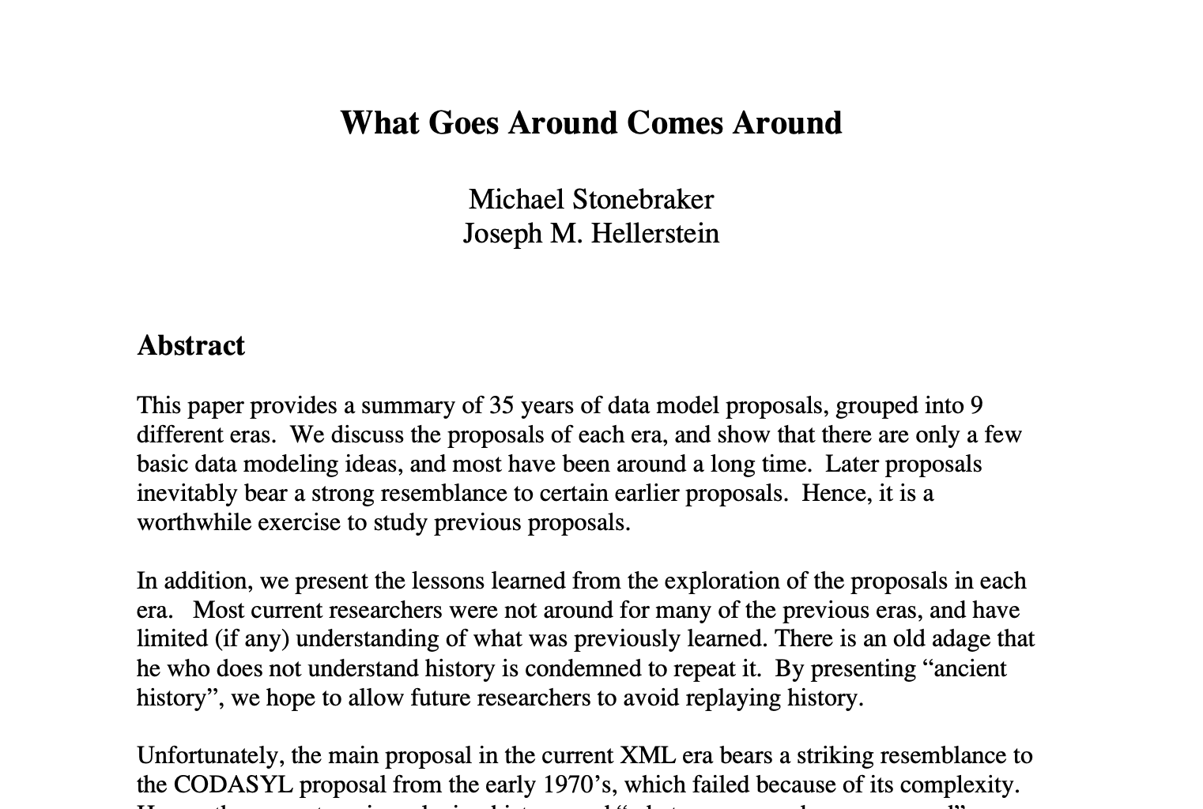
Short DB History

Slide 39
What is a Database?
Data stored in a representation
Records and relationships
Query the data
Write or generate algorithms to traverse storage representation
Innovations found in
Data representation
Query interface
Translating query interface → algorithms over data

Slide 40
60s Hierarchical Model
IMS: IBM Management System
For Apollo space program: Saturn V inventory
Still used by banks today
Each level is a different entity type
Schema
Database Instance
Cages
(cid, size)
01, 100ft²
02, 900ft²
Animals
(aid, species, name)
9, frog, yurt
9, frog, yurt

Slide 41
60s Hierarchical Model
# Animals living in cage 2
Find cage where cid = 2
Find 1st child of current record
Loop
Find next sibling record of same type
print record
Schema
Database Instance
Cages
(cid, size)
01, 100ft²
02, 900ft²
Animals
(aid, species, name)
9, frog, yurt
9, frog, yurt

Slide 42
60s Hierarchical Model
👎 Data redundancy if many to many relationship
Schema
Database Instance
Cages
(cid, size)
01, 100ft²
02, 900ft²
Animals
(aid, species, name)
9, frog, Jill
9, frog, yurt

Slide 43
60s Hierarchical Model
👎 Data redundancy if many to many relationship
👎 Animal can’t exist without a cage
👎 Removing cage removes animals
Schema
Database Instance
Cages
(cid, size)
Animals
(aid, species, name)
9, frog, yurt

Slide 44
60s Network Model (CODASYL)
Charles Bachman Turing #8
Record at a time navigation
Impossible to program
Changing data representation breaks programs
Keepers
(kid, name)
11, Chuck
12, Jane
Animals
(aid, species, name)
9, iguana, bob
10, dog, rex
11, cat, mochi
Cages
(cid, size)
01, 100ft²
02, 900ft²

Slide 45
60s Network Model
Find keeper where name = Jane
Loop
Find next animal in cares_for
Find Cage in lives_in
print record
Keepers
(kid, name)
11, Chuck
12, Jane
Animals
(aid, species, name)
9, iguana, bob
10, dog, rex
11, cat, mochi
Cages
(cid, size)
01, 100ft²
02, 900ft²

Slide 46
60s Network Model
Find keeper where name = Jane
Loop
Find next animal in cares_for
Find Cage in lives_in
print record
Keepers
(kid, name)
11, Chuck
12, Jane
Animals
(aid, species, name)
9, iguana, bob
10, dog, rex
11, cat, mochi
Cages
(cid, size)
01, 100ft²
02, 900ft²

Slide 47
60s Network Model
Broken
Find keeper where name = Jane
Loop
Find next animal in cares_for
Find Cage in lives_in
print record
Keepers
(kid, name)
11, Chuck
12, Jane
Animals
(aid, species, name)
9, iguana, bob
10, dog, rex
11, cat, mochi
Cages
(cid, size)
01, 100ft²
02, 900ft²

Slide 48
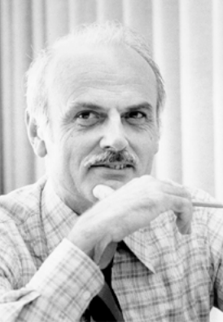
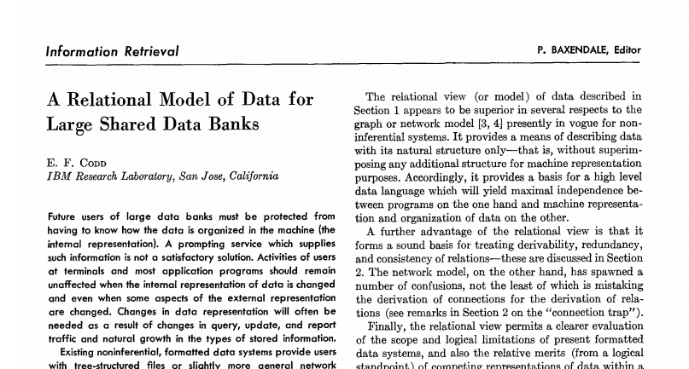
70s Relational Model
Edgar Codd Turing #18
Started the relational DB research field
Game changer
Set at a time language
Declarative language
Data independence

Slide 49
70s Relational Model
Keepers
Cages
kid | name
11 | Chuck
12 | Jan
cid | size
1 | 100ft²
2 | 900ft²
Cares_for
Lives_in
kid | aid
11 | 9
12 | 10
12 | 11
cid | aid
1 | 9
1 | 10
2 | 11
Animals
aid | name | name
9 | iguana | bob
10 | dog | rex
11 | cat | mochi

Slide 50
70s Relational Model
Keepers
Cages
kid | name
11 | Chuck
12 | Jan
cid | size
1 | 100ft²
2 | 900ft²
Cares_for
Lives_in
kid | aid
11 | 9
12 | 10
12 | 11
cid | aid
1 | 9
1 | 10
2 | 11
Animals
aid | name | name
9 | iguana | bob
10 | dog | rex
11 | cat | mochi

Slide 51
70s Relational Model
When do you want data independence?
δApp << δenvironment
- Hellerstein
Application logic evolves slowly
Technology evolves rapidly
Change data layout
Change schema
Change/upgrade hardware
Data system is remote
Cloud
…

Slide 52
70s Will it run?
Ingres @Berkeley
Stonebraker Turing #32 and Wang
Begat Ingres, Bitton-lee, Sybase, MS SQLServer, PACE, Tandem
System R @IBM
Jim Gray Turing #22
Big research team, 15 PhDs
Begat DB2, Oracle, HP Allbase, Tandem
Proved that theory is practical
Spawned RDBMS market and modern data-oriented software

Slide 53
80s Will it Sell?
Heavyweights
IBM doesn’t want to cannibalize IMS
Oracle reads System R papers, and goes to market first
IBM eventually releases DB2
IBM chooses SQL, Oracle follows, becomes the standard
Crowd of players
Jim Gray et al join Tandem
Stonebraker makes Ingres → Informix
Britton & Lee from Ingres create Britton-Lee
Epstein leaves BL to create SyBase (bought by SAP for $5B)
Wang creates PACE
Caltech alums start Teradata w/ networking tech → parallel DB

Slide 54
80s Object Oriented DBMS
Impedance mismatch between Objects and relational model
Struct person {
name string;
hobbies string[];
}
person
personhobbies
pid | name
1 | Chuck
2 | Jane
pid | hobby
1 | cheese
1 | surfing
Translation cumbersome
Wanted to avoid the join
Prefer DOT notation e.g., person.hobbies

Slide 55
80s Object Oriented DBMS
Impedance mismatch between Objects and relational model
Struct person {
name string;
hobbies string[];
}
person
{
pid: 1
name: “Chuck”
hobbies: [
“cheese”,
“surfing”
]
}
pid | name | hobbies
1 | Chuck | [cheese, surfing]
2 | Jane
Nested Relational Model

Slide 56
80s Object Oriented DBMS
Impedance mismatch between Objects and relational model
Struct person {
name string;
hobbies string[];
}
person
{
pid: 1
name: “Chuck”
hobbies: [
“cheese”,
“surfing”
]
}
pid | name | hobbies
1 | Chuck | [cheese, surfing]
2 | Jane
Hard to query against
Vender lock-in, language lock-in
NoSQL before it was cool
Mostly addressed by ORMs

Slide 57
90s More Money
Sybase licensed by Microsoft for x86 → Microsoft SQLServer
MySQL created
Postgres adds support for SQL → PostgreSQL
SQLite created.
Most popular DB in the world
Second most popular software library in the world (after zlib)

Slide 58
00s Data Warehouses aka OLAP
Companies accumulate transaction data, want to analyze
Want high throughput (OLAP)
Distributed shared nothing databases
Mostly closed source
Limited scalability (tens of nodes)
PostgreSQL begats Netezza, Greenplum
MonetDB from CWI
Vertica from MIT
Paraccel → RedShift

Slide 59
00s The Internet
Internet companies want scalability over all else
Give up most of RDBMS features for scalability
Schema, relational model, ACID, SQL, strong consistency
Rise of eventually consistent NoSQL stores
Open Source
BigTable, Dynamo, Hbase, MongoDB, Couchbase, Cassandra

Slide 60
10s NewSQL
Eventual consistency is difficult to program against
Scalable distributed DBs that support ACID, SQL
Shared nothing via partitioning (sharding)
Industry: Google Spanner, MemSQL, SAP Hana
Academic→ Company: Hstore → VoltDB, Hyper,
Open Source: Yugabyte, Cockroach

Slide 61
10s Cloud Databases
Cloud infrastructure = Scalable resource provisioning
Early on containerize open source databases
Provides devops, provisioning
Doesn’t best leverage cloud
AWS Postgresql, Amazon RDS
Cloud native databases
Optimized for distributed storage (shared disk)
Decouples storage and execution, scales independently
Lots of connectors to the “data lake”
Presto, Snowflake, Apache Drill, AWS Redshift, Azure Cloud

Slide 62
10s Specialized DBs
Graph systems
Graph API over relational (node, edge) data
CIDR 2015 GRAL: fast DBMS > specialized graph engines
Adage: graph traversals are joins. DBs are very good at joins
Neo4J, Dgraph, Graphbase, Giraph, GraphX
Time series
Timestamp + a few attributes
Custom indexing, execution for high performance
Timescale, InfluxDB, clickhouse,

Slide 63
10s Specialized DBs
Streaming
Events arrive in a “stream”
Querying over an infinitely growing table
Evolution of streaming systems
Continuous queries: SASE, Telegraph, STREAM
Sliding windows: Aurora, Oracle CQL
Scalability, Best-effort semantics: Twitter Storm
Out of order, state: Flink, Spark Streaming, Kafka, Materialized

Slide 64
10s DBs for X
Classic DB architecture are still good bones
RDBMS is mostly commodity
Market shift toward “massive scale” and “for X”
Where X is
Ads
Video
Astronomy
ML
Vis
…
Rule of thumb
10x better not enough
>50x better

Slide 65
At the end of the day
Main Market: DB Apps & Services
Salesforce: CRM
IBM, SAP, Oracle: CRM, supply chain, inventory, HR
Adobe: marketing, advertisement
Google, FB, Yandex, Twitter: the web, search
Microsoft: productivity, cloud
Amazon: commerce, cloud
Each company created major DBMSes

Slide 66









At the end of the day
Main Market: DB Apps & Services
Database Management Technology

Slide 67
Your Tasks for next class
Submit reviews for Thursday
Submit Assignment 0 by 9/13 11:59PM EST
w6113.github.io

